Slide 1


CS 235: User Interface Design April 28 Class Meeting
Department of Computer Science San Jose State University Spring 2015 Instructor: Ron Mak
www.cs.sjsu.edu/~mak

Slide 2
Unofficial Field Trip
Computer History Museum in Mt. View
http://www.computerhistory.org/
Saturday, May 9, 11:30 – closing time
Special free admission.
Do a self-guided tour of the new Revolution exhibit.
See a life-size working model of Charles Babbage’s Difference Engine in operation, a hand-cranked mechanical computer designed in the early 1800s.
Experience a fully restored IBM 1401 mainframe computer from the early 1960s in operation.
General info: http://en.wikipedia.org/wiki/IBM_1401
My summer seminar: http://www.cs.sjsu.edu/~mak/1401/
Restoration: http://ed-thelen.org/1401Project/1401RestorationPage.html
Extra credit
fun quiz!

Slide 3
Final Project
Each team chooses one or more datasets.
Develop a data visualization application (web or desktop).
The application provides a story or narrative.
Employ UI principles and design patterns.
Who are the users?
What are their goals?
How will they use the application?

Slide 4
Final Project, cont’d
Create visualizations of the data.
Employ visualization principles and design patterns.
Static and/or dynamic visualizations.
Data streaming can be simulated by reading from a file.
Visualizations should be on multiple pages.
Use navigation design patterns.
Data visualizations should be creative, but they must convey useful information in a way that users can understand and use.
What insights can you provide?

Slide 5
Final Project Presentations
Thursday, May 21
12:15 – 2:30 PM
Each team has 20 minutes to present and for questions and answers.

Slide 6
Final Project Report: Due Friday, May 22
What is the purpose of your application?
Who will use it and what are their goals?
How did you fulfill the goals?
What are your data sources?
What do your visualizations show?
How did you create the visualizations?
Screen shots.
How to run your application?

Slide 7
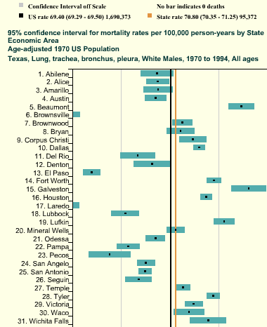
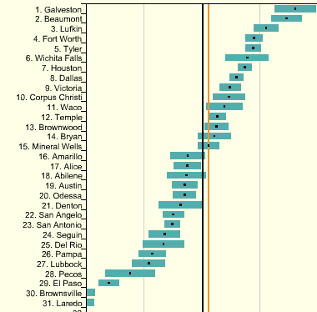
Another Sorting Example
Designing Interfaces, 2nd ed.
by Jenifer Tidwell
O’Reilly, 2011

Slide 8
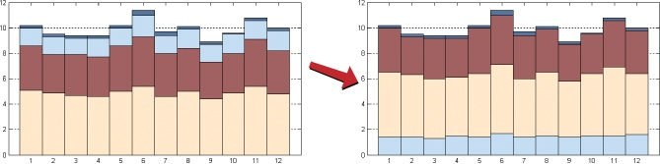
Rearranging Data
In a stacked bar chart, move the variable you want to compare to the base line.
Example: The variable represented by blue.
Designing Interfaces, 2nd ed.
by Jenifer Tidwell
O’Reilly, 2011

Slide 9
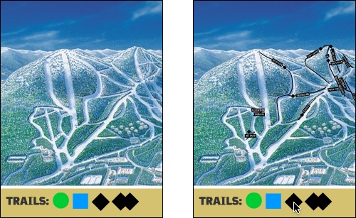
Another Filtering Example
Designing Interfaces, 2nd ed.
by Jenifer Tidwell
O’Reilly, 2011

Slide 10
Design Patterns for Data Visualization
Overview Plus Detail
Data Tips
Data Spotlight
Dynamic Queries
Data Brushing
Local Zooming
Sortable Table
Radial Table
Multi-Y Graph
Small Multiples
Treemap

Slide 11
Overview Plus Detail
What
Graphic overview next to a zoomed detail view.
User drags a viewport over the overview.
When
Show the big picture.
Allow the user to zoom in for more detail.
Why
Deal with complexity.

Slide 12
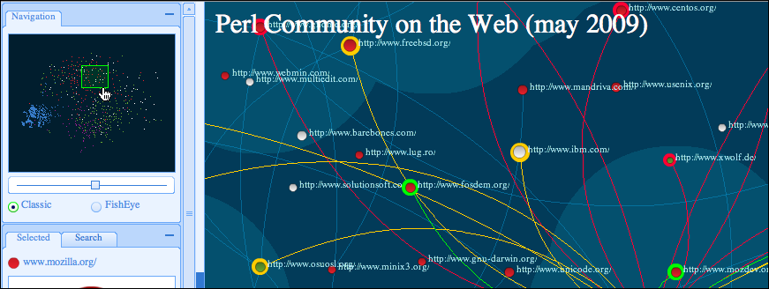
Overview Plus Detail
Designing Interfaces, 2nd ed.
by Jenifer Tidwell
O’Reilly, 2011

Slide 13
Data Tips
What
Pop up data values on mouse rollover.
When
Show detail about specific points on an overview.
Why
Easy to find data values for further analysis.

Slide 14
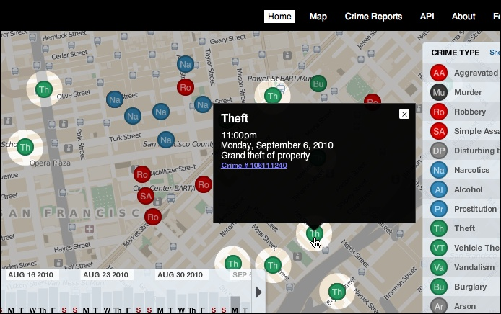
Data Tips, cont’d
Designing Interfaces, 2nd ed.
by Jenifer Tidwell
O’Reilly, 2011

Slide 15
Data Spotlight
What
Highlight data that the mouse rolls over.
Dim the rest.
When
Very rich data graphic that obscures relationships.
Complex multivariate data with dependencies.
Why
“Focus plus context”: Untangle data threads.

Slide 16
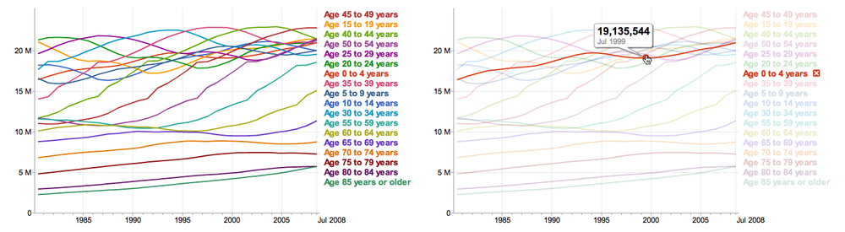
Data Spotlight, cont’d

Slide 17
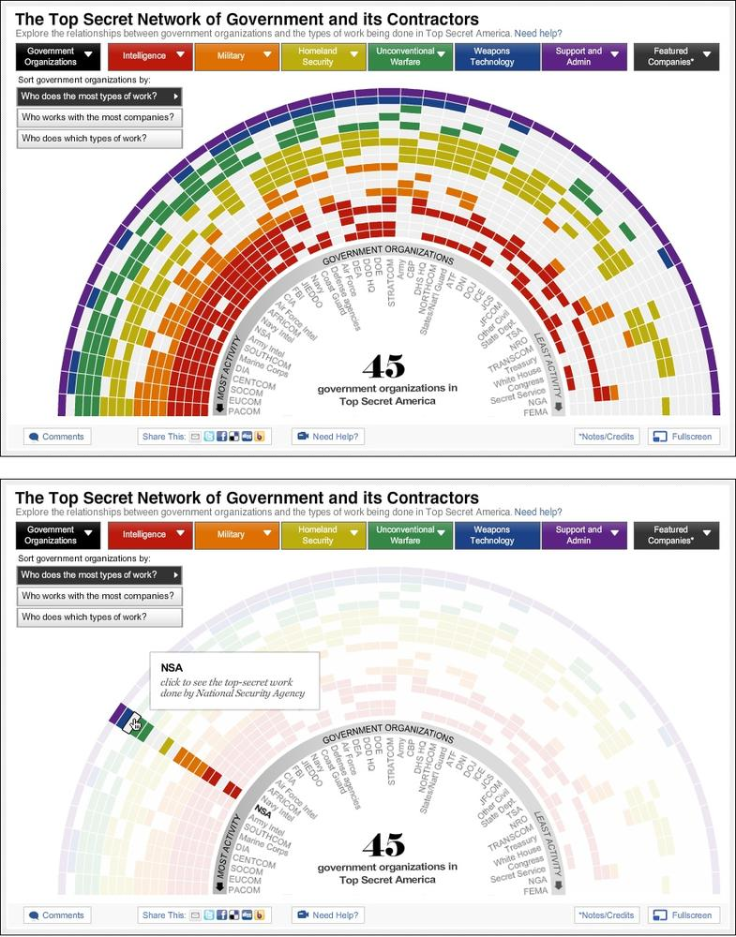
Data Spotlight, cont’d
Designing Interfaces, 2nd ed.
by Jenifer Tidwell
O’Reilly, 2011

Slide 18
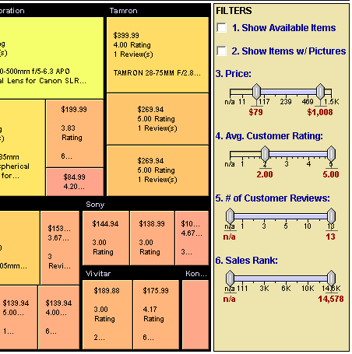
Dynamic Queries
What
Standard controls to filter data dynamically.
When
Large multivariate data with a fixed set of attributes.
Users need to filter out some of the data.
Why
Easy to learn controls.
Encourage open-ended data exploration.
Designing Interfaces, 2nd ed.
by Jenifer Tidwell
O’Reilly, 2011

Slide 19
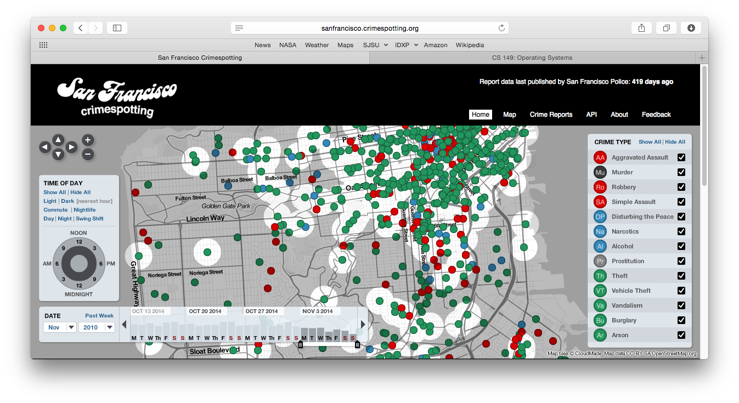
Dynamic Queries, cont’d
Designing Interfaces, 2nd ed.
by Jenifer Tidwell
O’Reilly, 2011

Slide 20
Data Brushing
What
Highlight the same data in multiple graphs.
When
Show multiple graphs of the same data.
Why
Very rich form of interactive data exploration.
Users can see the same data in multiple contexts.
Linked views: Synchronized selection, panning, etc.

Slide 21
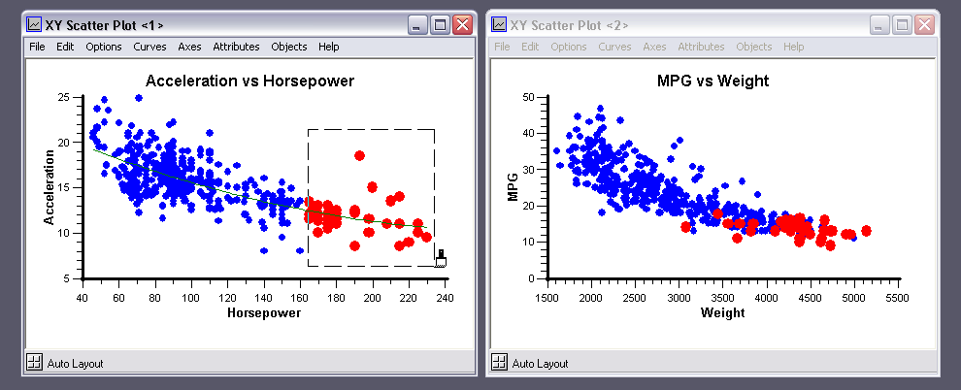
Data Brushing, cont’d
Designing Interfaces, 2nd ed.
by Jenifer Tidwell
O’Reilly, 2011

Slide 22
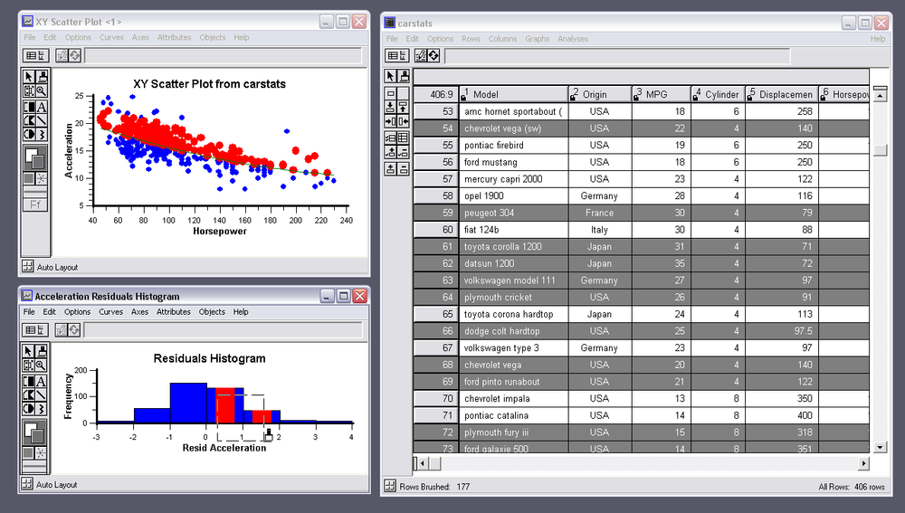
Data Brushing, cont’d
Designing Interfaces, 2nd ed.
by Jenifer Tidwell
O’Reilly, 2011

Slide 23
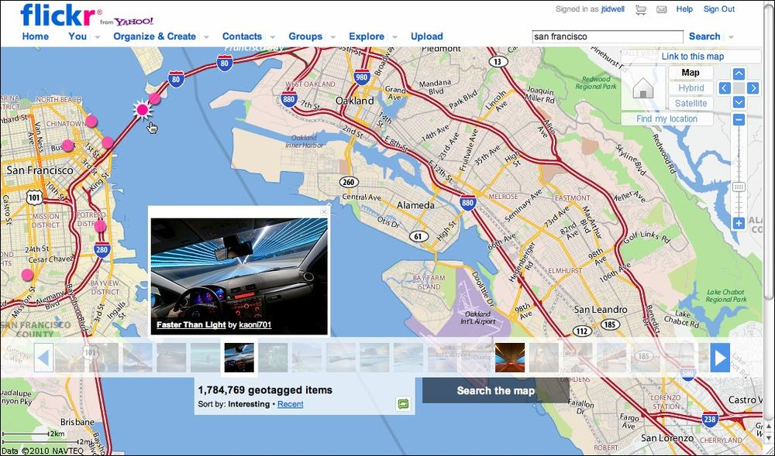
Data Brushing, cont’d
Designing Interfaces, 2nd ed.
by Jenifer Tidwell
O’Reilly, 2011

Slide 24
Local Zooming
What
Show all data in a single dense page with small-scale data items.
Wherever the mouse goes, automatically enlarge those data items.
When
Users need an overview when browsing or searching through the data.
Why
Ordinary zooming causes the user to lose context by removing the overview.

Slide 25
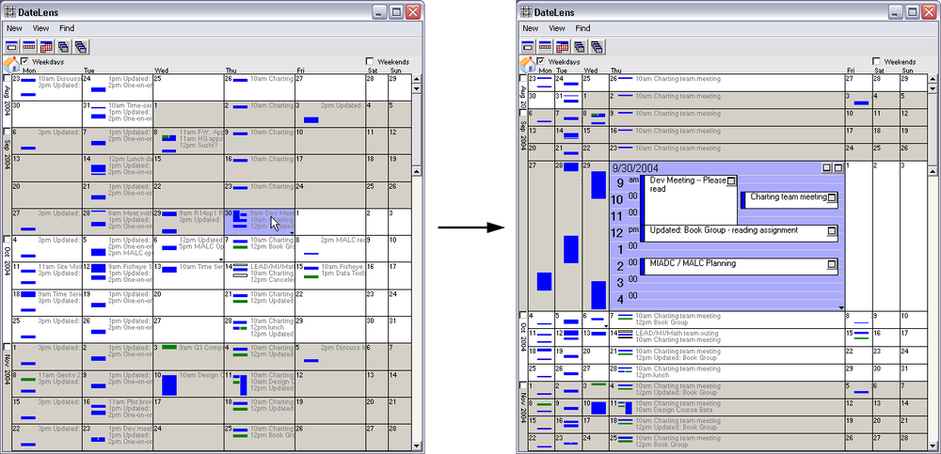
Local Zooming, cont’d
Designing Interfaces, 2nd ed.
by Jenifer Tidwell
O’Reilly, 2011

Slide 26
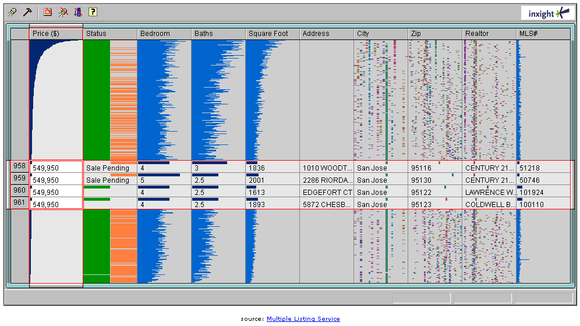
Local Zooming, cont’d
Designing Interfaces, 2nd ed.
by Jenifer Tidwell
O’Reilly, 2011

Slide 27
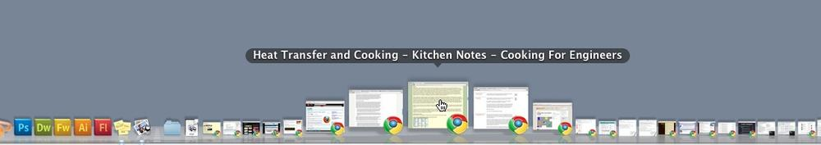
Local Zooming, cont’d
Designing Interfaces, 2nd ed.
by Jenifer Tidwell
O’Reilly, 2011

Slide 28
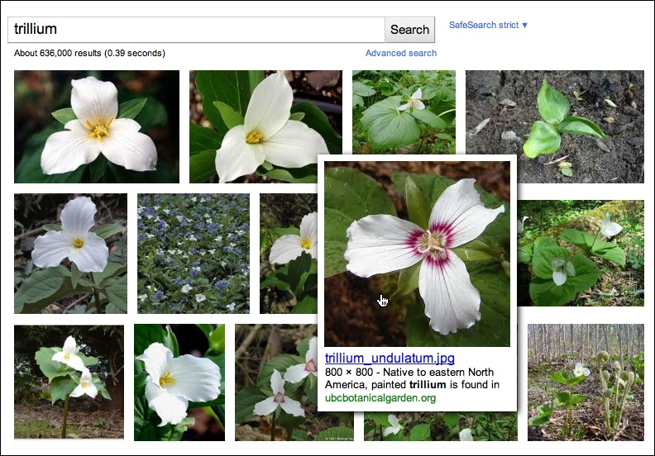
Local Zooming, cont’d
Designing Interfaces, 2nd ed.
by Jenifer Tidwell
O’Reilly, 2011

Slide 29
Sortable Table
What
Display data in a table.
Allow the user to sort by a selected column.
When
Multivariate data needs to be sorted by different columns to provide additional insights.
Why
Users want to explore, reorder, customize, search, or understand the data using different variables.

Slide 30
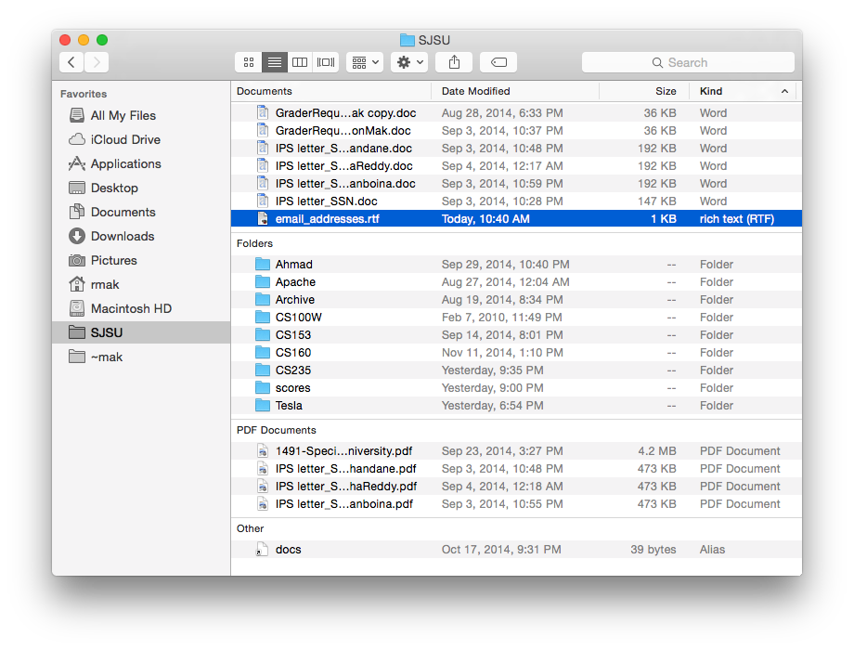
Sortable Table, cont’d
Designing Interfaces, 2nd ed.
by Jenifer Tidwell
O’Reilly, 2011

Slide 31
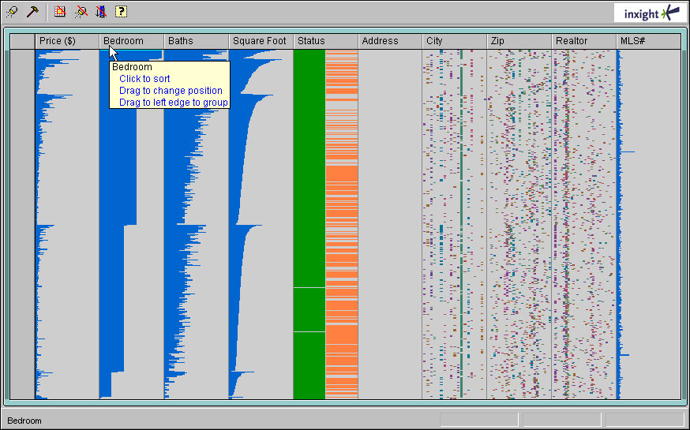
Sortable Table, cont’d
Designing Interfaces, 2nd ed.
by Jenifer Tidwell
O’Reilly, 2011

Slide 32
Radial Table
What
Arrange a list of items in a circle.
Draw connections among items through the circle.
When
Need to show arbitrary relationships among items.
Can encode numerical values using line thickness.
Why
Easier visualization of relationships.
Users can see patterns more easily.
Visualizations can be beautifully drawn.

Slide 33
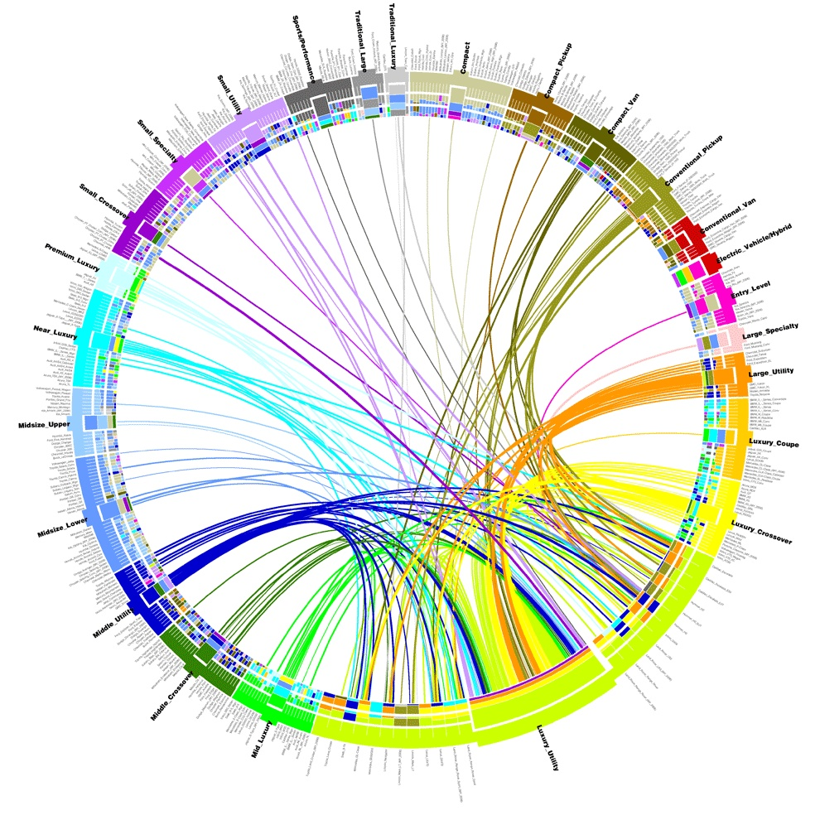
Radial Table, cont’d
Designing Interfaces, 2nd ed.
by Jenifer Tidwell
O’Reilly, 2011

Slide 34
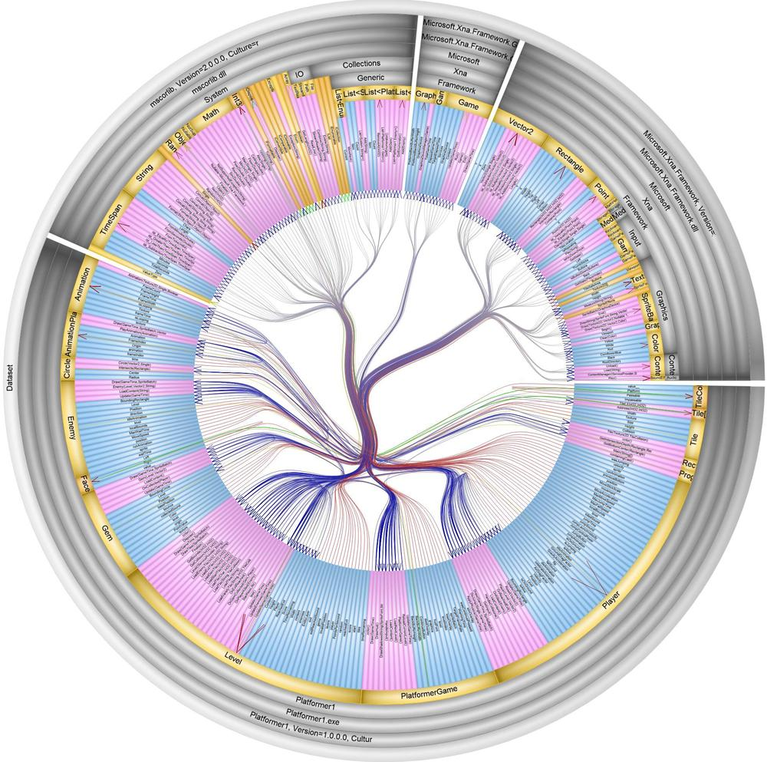
Radial Table, cont’d
Designing Interfaces, 2nd ed.
by Jenifer Tidwell
O’Reilly, 2011

Slide 35
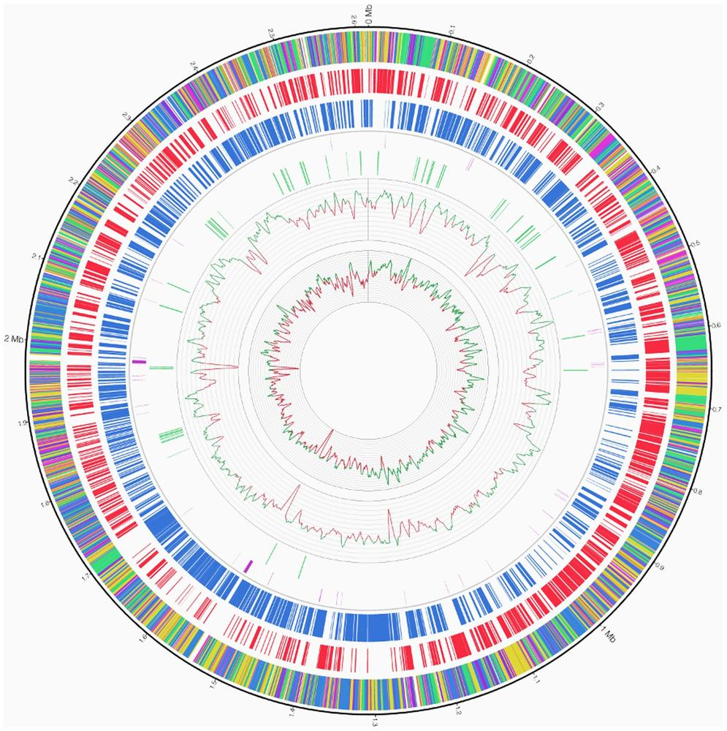
Radial Table, cont’d
Designing Interfaces, 2nd ed.
by Jenifer Tidwell
O’Reilly, 2011

Slide 36
Multi-Y Graph
What
Multiple graphs stacked vertically.
All share the same x-axis.
When
Several graphs share the same x-axis, often a timeline.
The graphs may have different y-axes.
Why
Let users know the graphs are related.
Encourage comparisons among the graphs.

Slide 37
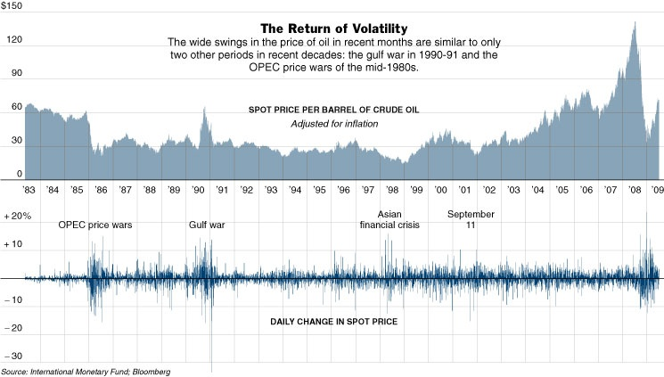
Multi-Y Graph, cont’d
Designing Interfaces, 2nd ed.
by Jenifer Tidwell
O’Reilly, 2011

Slide 38
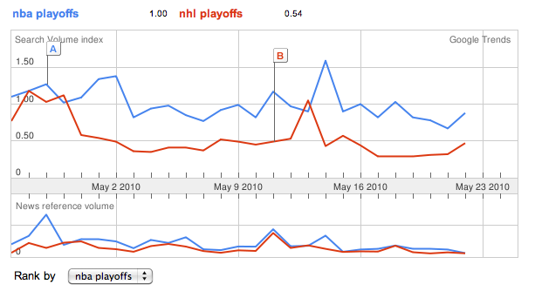
Multi-Y Graph, cont’d
Designing Interfaces, 2nd ed.
by Jenifer Tidwell
O’Reilly, 2011

Slide 39
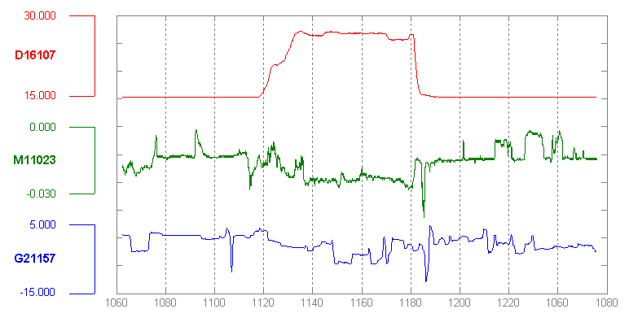
Multi-Y Graph, cont’d
Designing Interfaces, 2nd ed.
by Jenifer Tidwell
O’Reilly, 2011

Slide 40
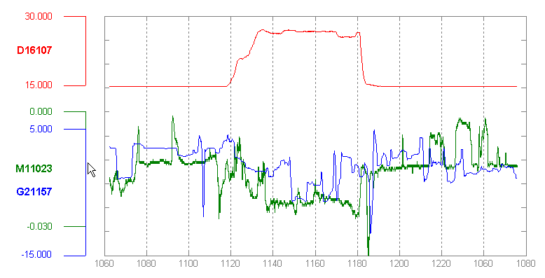
Multi-Y Graph, cont’d
Alternative: Superimposed graphs.
Designing Interfaces, 2nd ed.
by Jenifer Tidwell
O’Reilly, 2011

Slide 41
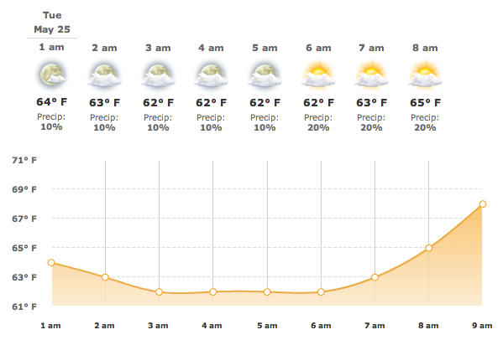
Multi-Y Graph, cont’d
Designing Interfaces, 2nd ed.
by Jenifer Tidwell
O’Reilly, 2011

Slide 42
Small Multiples
What
Tile many small graphs.
When
Show multiple dimensions of a large dataset at once.
Large display area – not good for mobile devices.
Why
Show how data changes from one picture to the next.
No paging necessary.
Sequential presentation.
3-D presentation.

Slide 43
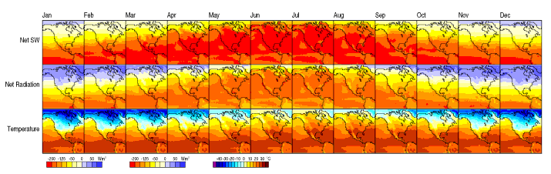
Small Multiples
Designing Interfaces, 2nd ed.
by Jenifer Tidwell
O’Reilly, 2011

Slide 44
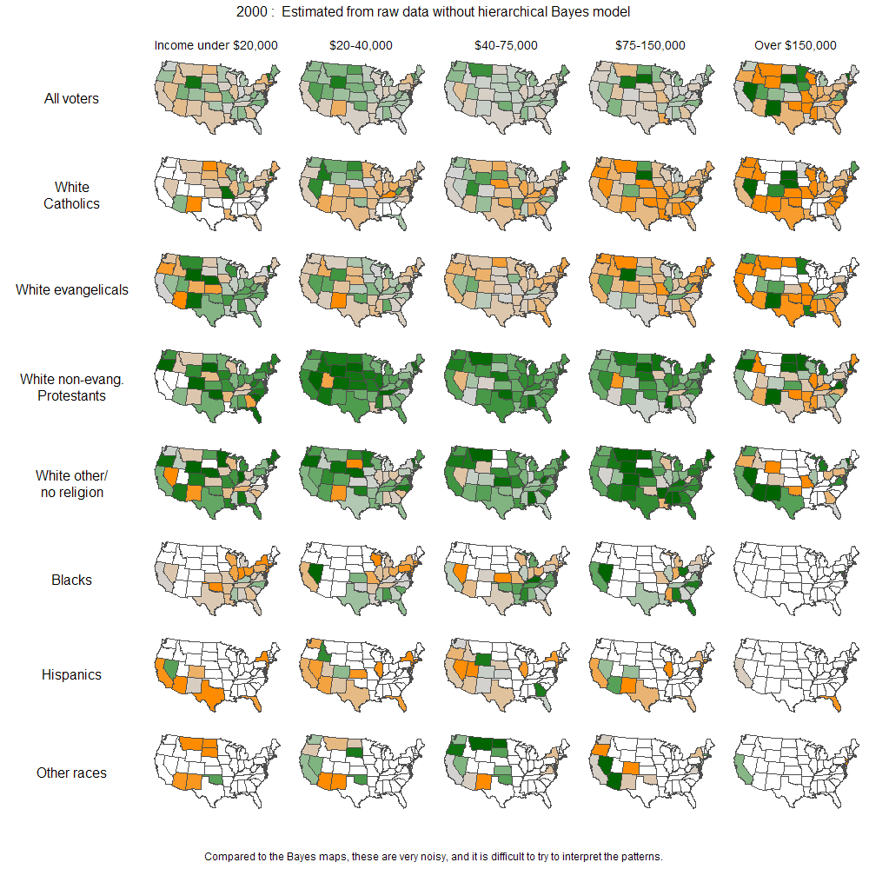
Small Multiples, cont’d
Designing Interfaces, 2nd ed.
by Jenifer Tidwell
O’Reilly, 2011

Slide 45
Treemap
What
Nested rectangles to show multidimensional and/or hierarchical data.
When
Hierarchical data.
Multivariate data that can be grouped by their common attributes.
Why
Pack much information into a single space.
Encourage users to seek trends and relationships.

Slide 46
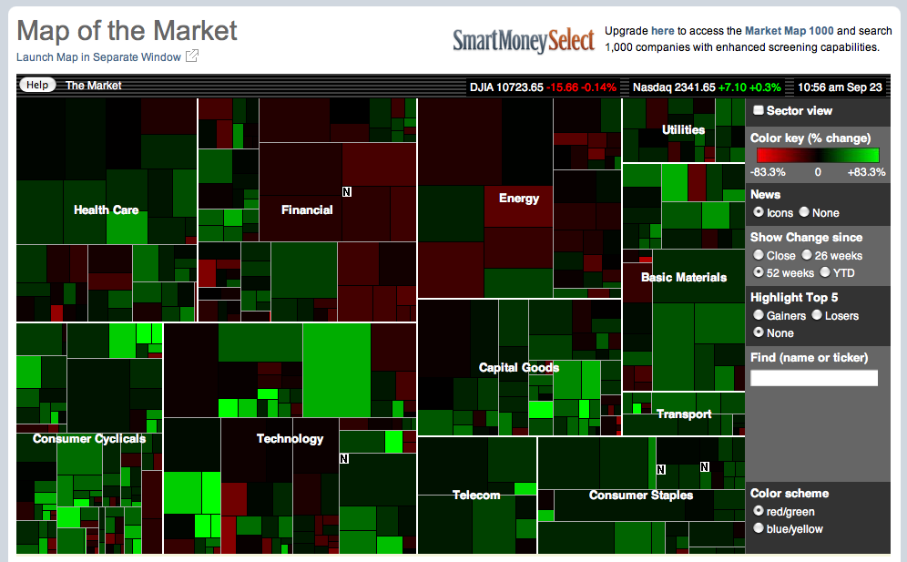
Treemap, cont’d
Designing Interfaces, 2nd ed.
by Jenifer Tidwell
O’Reilly, 2011

Slide 47
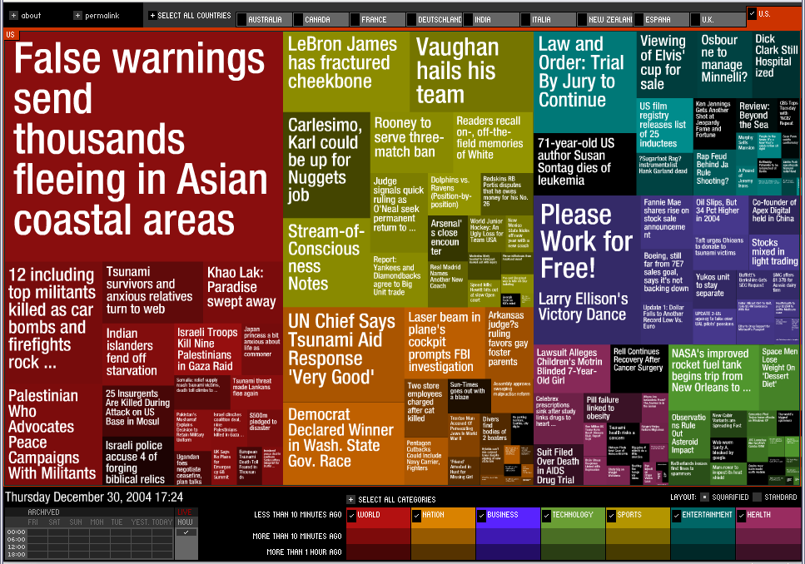
Treemap, cont’d
Designing Interfaces, 2nd ed.
by Jenifer Tidwell
O’Reilly, 2011

Slide 48
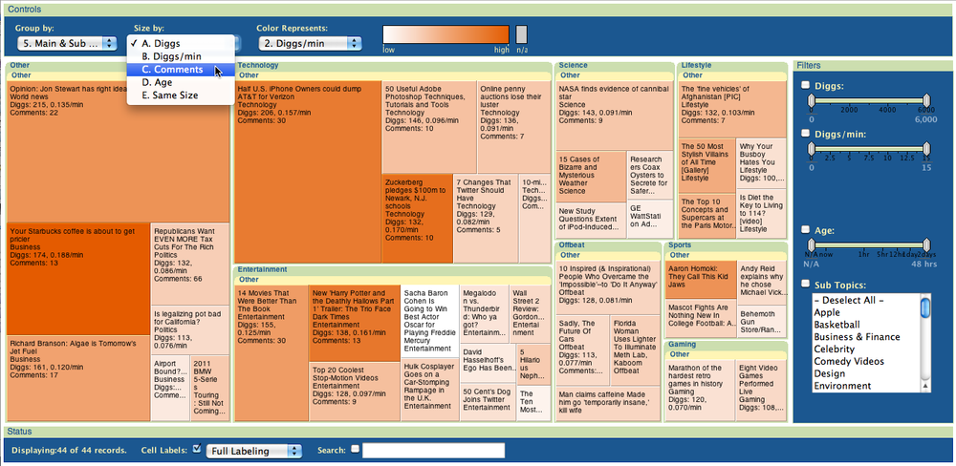
Treemap, cont’d
Designing Interfaces, 2nd ed.
by Jenifer Tidwell
O’Reilly, 2011

